Slide 1


DBS Project 2 Report
Courses Selection System
22CST Yusi (蒋云翔)
Wednesday, December 18, 2024

Slide 2

Catalogue
01.
02.
03.
Project Introduction
Overview
System function display
04.
Conclusion and comparison

Slide 3

01.
Project Introduction
Brief introduction
Core requirements of the project

Slide 4
Brief Introduction of project 2
Design and implement an DB-based partial application system on Teaching Administration Management, and mainly implement Select-Courses with necessary helper features (view selectable courses and selected courses, adjust selected courses etc.), considering the following constraints: prerequisite courses, credit limit (no more than 21 credits in one semester), and no time conflicts for selected courses.

Slide 5
Core requirement of this project
Key functions:
view selectable courses
selected courses
adjust selected courses
Some restrictions:
no more than 21 credits
no time conflicts for selected courses

Slide 6
02.
Overview of my own Project

Slide 7
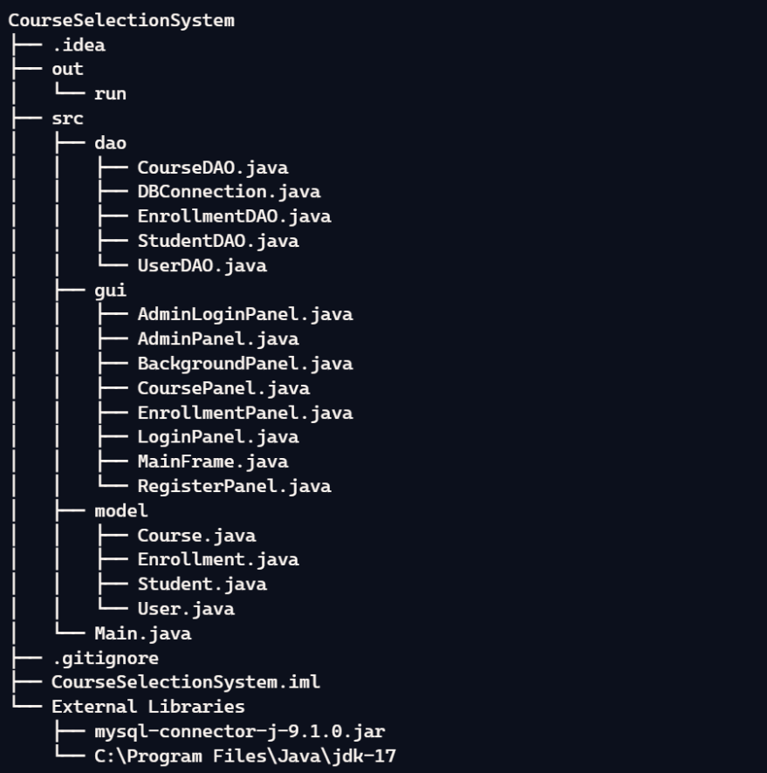
File Structure

Slide 8
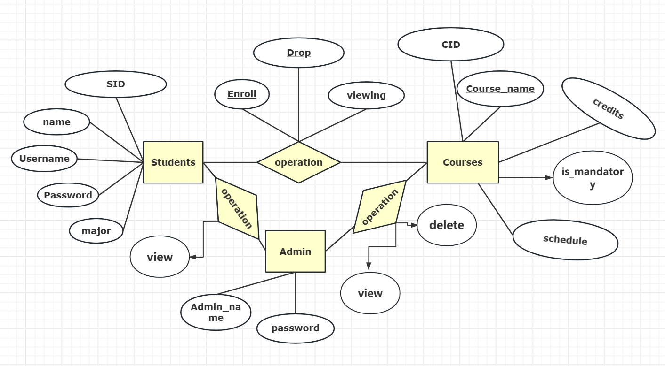
E-R diagram

Slide 9
Project overview
This Course Selection Management System is a database-driven application designed for Teaching Administration Management, primarily focusing on course enrollment functionalities. The system provides two different interfaces for students and administrators, each with their respective functionalities.
The system aims to simplify and optimize the course selection process for students, addressing the cumbersome issues of traditional manual selection systems, and enhancing the efficiency of course enrollment. By offering a user-friendly interface and powerful features, the system meets the diverse needs of both students and administrators, ensuring a smooth course selection process.

Slide 10
03.
System function display

Slide 11
04
Conclusion and comparison

Slide 12
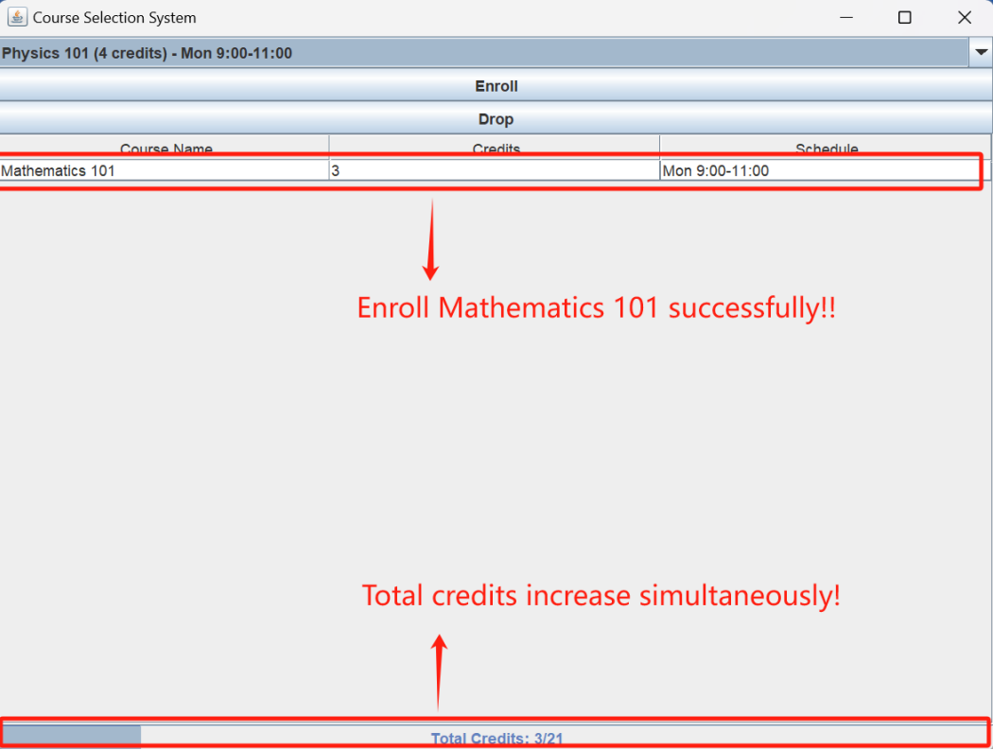
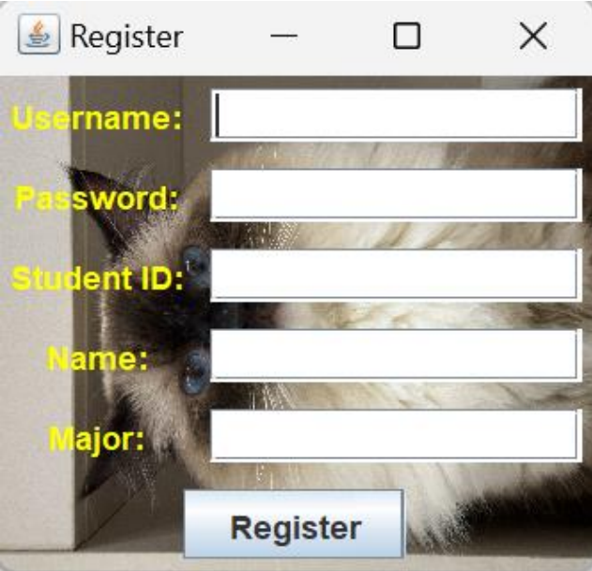
Some newly added function
Students Features:
Security and Personalization:
Set up Password:
Students can securely login the system using its personal password to protect their personal data.
View Personal Information:
Students can view all enrolled courses and track the total credits earned, ensuring they do not exceed the 21-credit limit.

Slide 13
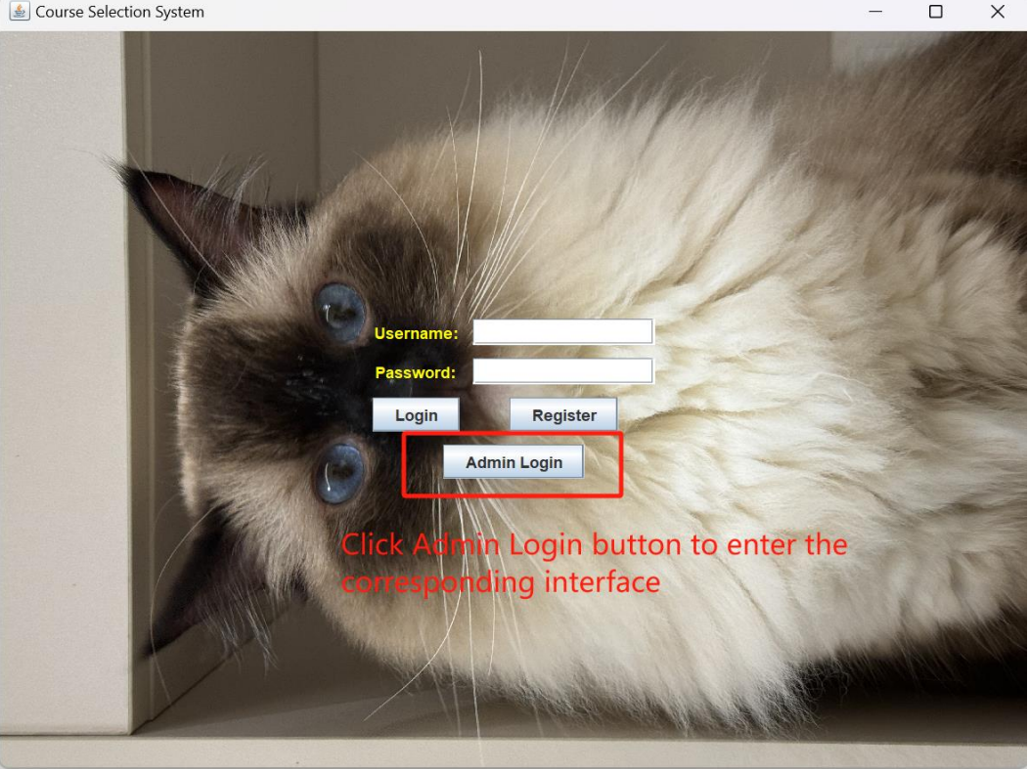
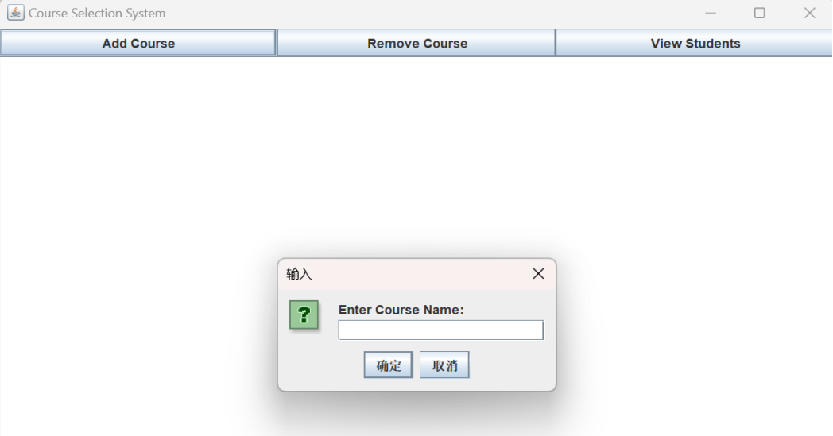
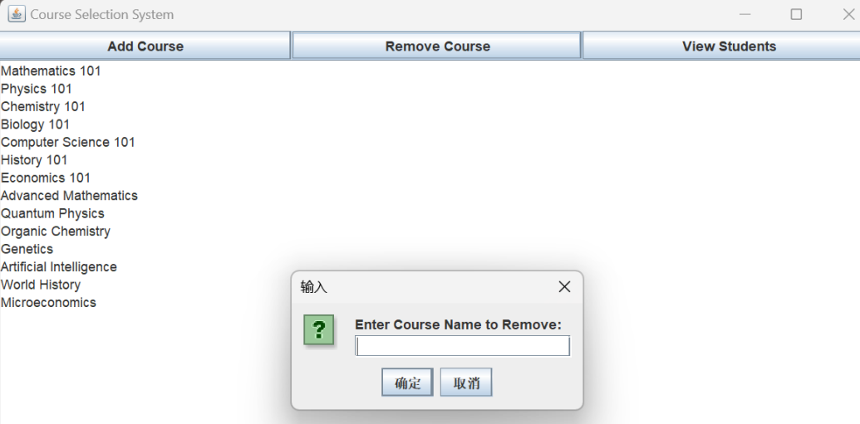
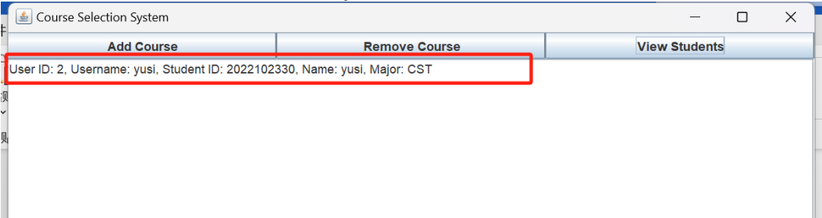
Some newly added function
2. Administrator Features:
Add Courses:
Administrators can add new courses to the system, including course names, credits, schedules, and mandatory status.
Remove Courses:
Administrators can delete existing courses, ensuring the accuracy and timeliness of the course catalog.
View Student Information:
Administrators can view detailed information about all registered students, including usernames, student IDs, names, and majors.

Slide 14
Thanks!
Please keep this slide for attribution

